Slide 1


Building GraphQL API’s with .NET Core
By Corstian Boerman

Slide 2

HELLO!
I’m Corstian
Software developer, aviation enthusiast and (recovering) coffee addict.

Slide 3

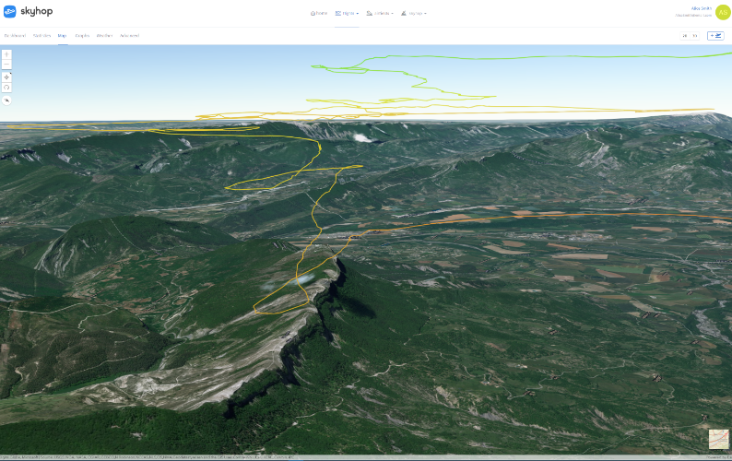
SKYHOP
SkyHop is a flight analysis platform aimed towards glider pilots. In order to be able to build this platform by myself I have exposed it’s data through a GraphQL endpoint.
Notes:
This is where it initially originated

Slide 4


Slide 5

It’s all on GitHub!
https://github.com/corstian/gql-dotnet-presentation
Contains:
Source code for the demo
These slides

Slide 6
Feel free to ask questions!

Slide 7
Goals
What are we going to achieve?
Notes:
Goals:
Faster development cycle
2 man 1 day prototype
Write quality software

Slide 8
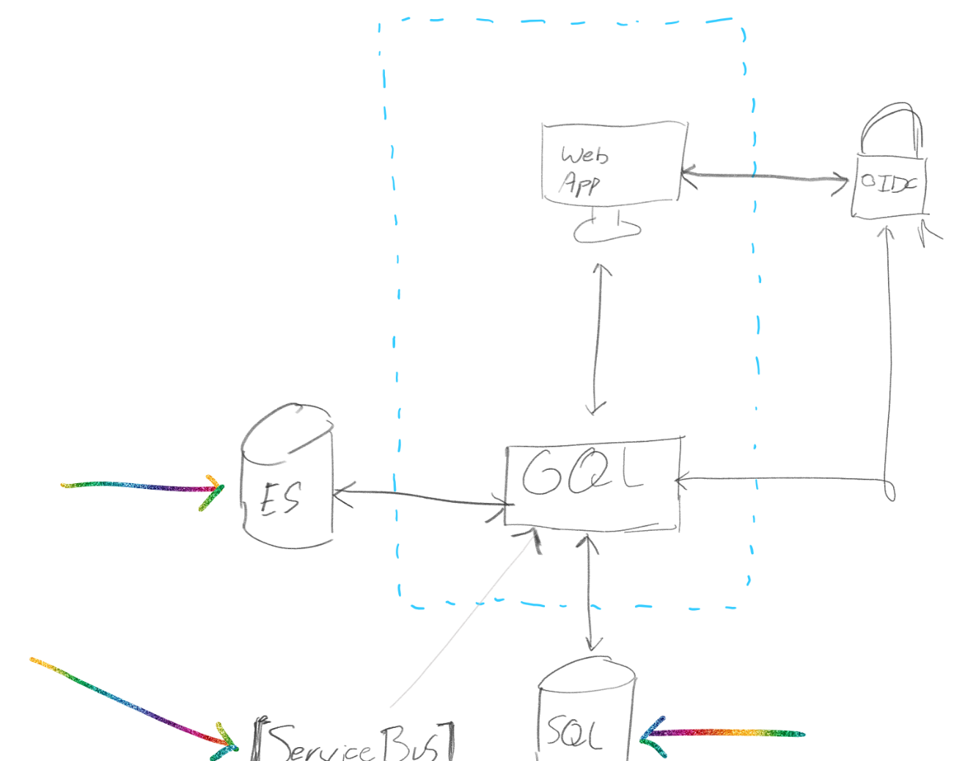

Notes:
The blue dashed area is where one would want to have their development focus.
Points:
Development focus
External integration
Unified model
External data processing etc.
The graph is an interface for an external application

Slide 9
“ The only way to keep on going while working myself into a burnout was to simplify the code-base at a higher rate than my cognitive decline. ”
Me (Corstian Boerman)
Notes:
I have been writing code with the mental state which was worse than that of a four year old. At a certain point my 4 year old son had to get me going to get to the supermarket because I did not have an overview over said task.

Slide 10
What is GraphQL?
We know what it does, but what is it?

Slide 11
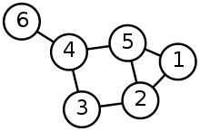
What is a graph?
(According to Wikipedia)
Graph (abstract data type)
An abstract data type representing relations and/or connections.
Conceptual graph
A model for knowledge representation and reasoning.
Notes:
Multiple entities connected with each other.
Object model
POCO

Slide 12
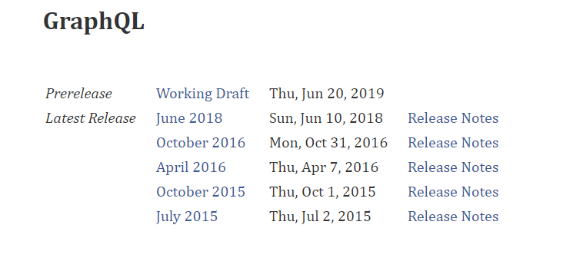
Source: https://graphql.github.io/graphql-spec/
Notes:
Developed internally in 2012
Publicly released in 2015
Moved to the GraphQL Foundation in November 2018, which is governed by the Linux Foundation

Slide 13

Notes:
Nick Schrock (Co-founder of GraphQL) on wat problem they have been trying to solve with GraphQL. Full documentary: https://www.youtube.com/watch?v=783ccP__No8

Slide 14
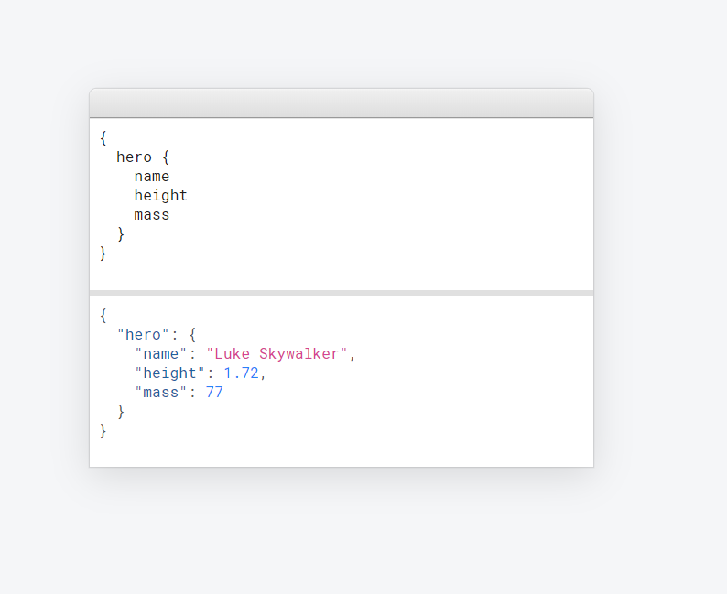
Notes:
This is the essence of GraphQL: requesting a certain amount of data, and retrieving a JSON document following the same structure

Slide 15
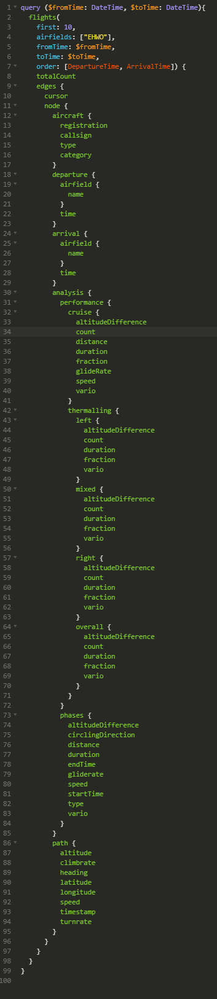
Notes:
This query returns 14 different objects, times 10.

Slide 16
BOLD STATEMENTS
GraphQL increases productivity
GraphQL reduces complexity
The GraphQL specification brings predictability when working with these API’s. This results in higher development speed as you already know what to expect without diving into the details.
And then there are all the community backed tools which improve the developer experience.
The way the graphql-dotnet library has been built kind of forces you to write code in a way which is highly reusable and can be quite minimalistic when compared to (for example) ASP.NET MVC.
GraphQL improves maintainability
GraphQL lets you focus on real business
The simple and minimalistic nature of this project reduces cognitive load with developers so they can focus on the important bits. The generic nature of the library eliminates the kind of bugs which appear due to code duplication.
Implementation details have no place in a well designed API. GraphQL makes it incredibly easy to abstract these away to let you focus on what matters most.
Notes:
Productivity:
Quick prototyping
(Super) DRY
No need to write any code more than once
Complexity:
DRY
Graph
Maintainability:
DRY
Real business:
No need for implementation details

Slide 17
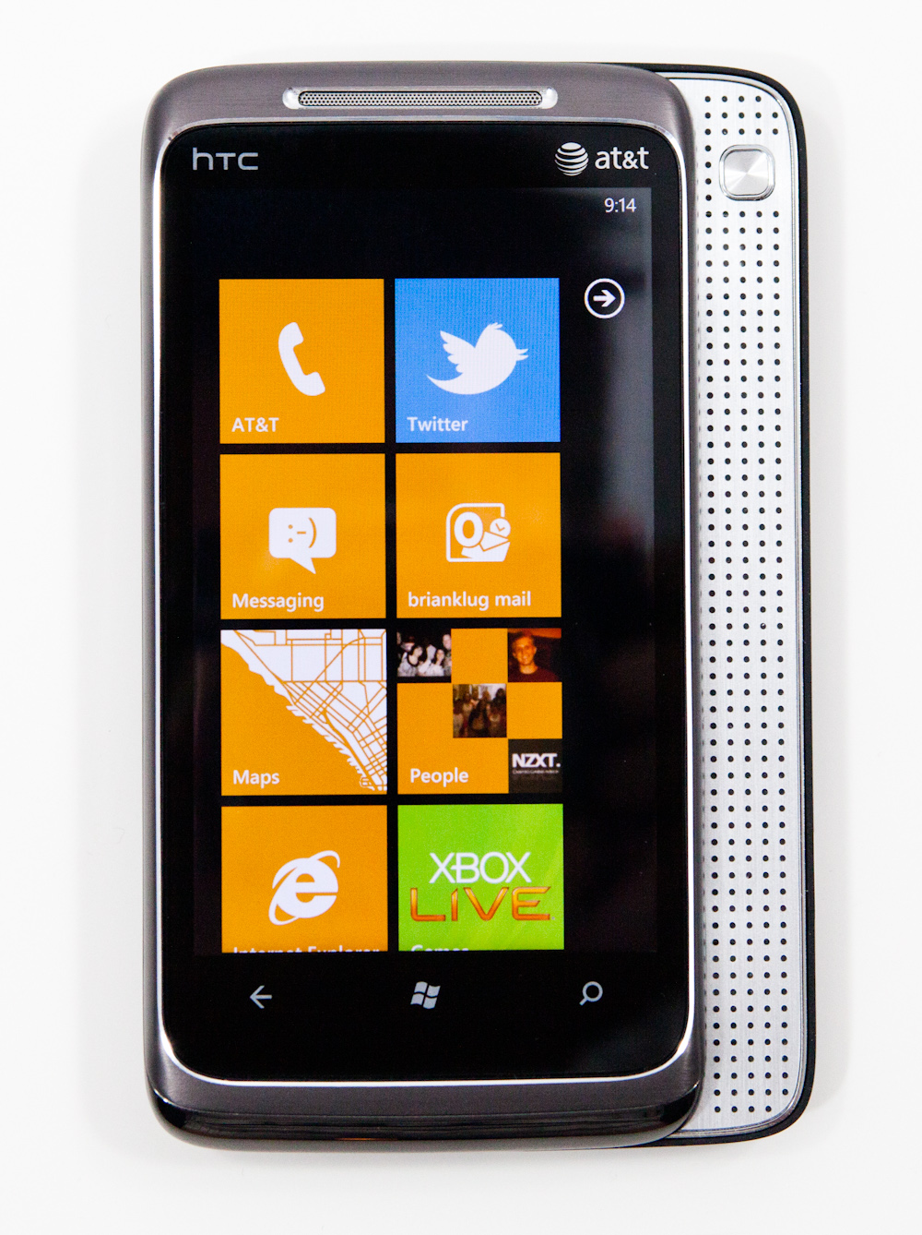
Windows Phone 7
And why it was awesome in the first place…
Notes:
Tell the file-explorer annecdote
Points;
Trading a little flexibility for consistency isn’t that crazy

Slide 18
CLIENT LIBRARIES IN ALL MAJOR LANGUAGES
JavaScript
Python
Swift
JavaScript has dozen of client implementations. There is always a good fitting library, but this is mostly dependent on the framework you are (not) using.
Python is amazing for data-science experiments. Having the ability to write gql queries directly from python is just totally amazing.
Are you writing apps for iOS? You’re in luck!
C#
Java
Many more, and HTTP!
This is probably not the main target for this audience, but who knows. There are libraries for this language.
I have probably used the wrong term in the wrong audience but whatever. Show some love for legacy java apps (or Android).
In the end the specification is open, and all operations are done over a HTTP POST call either way.
So feel free to implement your own.

Slide 19
Why not?
With this in mind, the marketing department would inform the department to create a prototype.

Slide 20
It’s <generic>
Notes:
Points:
Small changes can have lots of unintended errors
Basic expectation of performance
Optimizations can always be added later on.
Generic code brings development speed
Generic code brings simplicity

Slide 21
It’s NEW
(and therefore unknown)

Slide 22
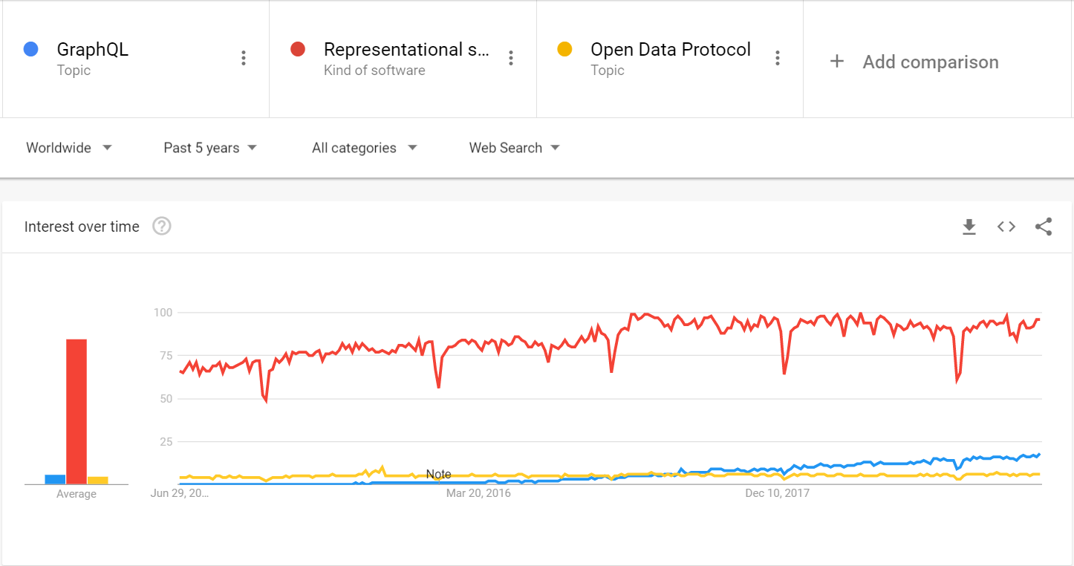
Notes:
Which of these three does not belong?
While on this topic, let’s discuss some changes:
REST:
Do everything and anything you want
Based around CRUD (coming from a database perspective, 1984)
ODATA:
REST, but more structured
“The best way to REST”
Focus on standardizing query operators
Small preparation for a graph because of resource links. URI’s to related resources.
GraphQL:
Focus on a graph model (related entities are the most important aspect)
Includes a separate query language
Dynamic responses!!
Most, if not all of the functionality from GraphQL can be implemented using REST, but at great cost, without the standardization.

Slide 23
It’s Open Source
/ community backed
Notes:
Points:
No paid support
You’re on your own with errors

Slide 24
THE CONCEPTS
QUERIES
MUTATIONS
SUBSCRIPTIONS
Retrieval of data
No side effects (by convention)
Nestable (the “graph”)
Parallel execution
Execution of “mutations”
RPC Style
CRUD Style
Whatever-you-want-style
Guaranteed execution order
Real-time data
Nestable…

Slide 25
LET’S TALK CODE!

Slide 26
(TECHNICAL) BACKGROUND
In order to be able to make optimal use of the graphql-dotnet library a few things might need to be clarified.

Slide 27
TOPICS COVERED
QUERIES
MUTATIONS
SUBSCRIPTIONS
Queries are used to retrieve data via the GraphQL endpoint
A mutation can be used to, well, mutate data.
A subscription is just like a query, with the difference that it can keep sending data continuously.
INTEGRATION
PROTOTYPING
BEST PRACTICES
How can GraphQL be integrated into existing (back-end) environments?
Quickly sketching out the API surface for direction with the front-end team.
Some common pitfalls, and how to avoid them.

Slide 28
TOPICS NOT COVERED
DATA LOADERS
CONNECTIONS
AUTHORIZATION
Although required to build a performant GraphQL api, it falls outside the scope of this introduction.
Properly implementing pagination takes a lot of time, thankfully the specification already accounted for this.
Authorization infrastructure alone is already quite a complex and diverse topic.
RATE LIMITING
VERSIONING
Outside the scope, but totally possible within literally minutes.
When designed right, you (usually) just don’t need to.

Slide 29
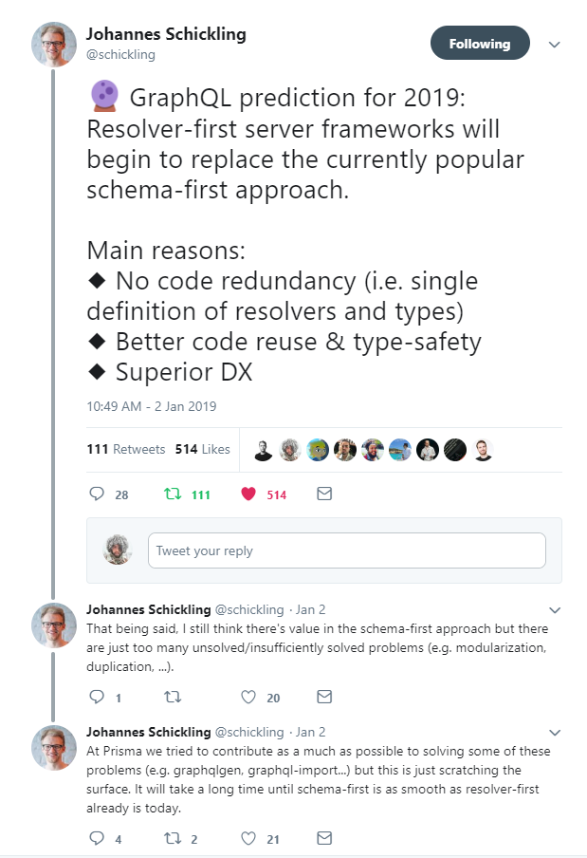

Slide 30

Notes:
Source of the image: https://www.prisma.io/blog/the-problems-of-schema-first-graphql-development-x1mn4cb0tyl3
Points:
graphql-js: reference implementation from Facebook
Schema first: focus on the API structure (positive)

Slide 31
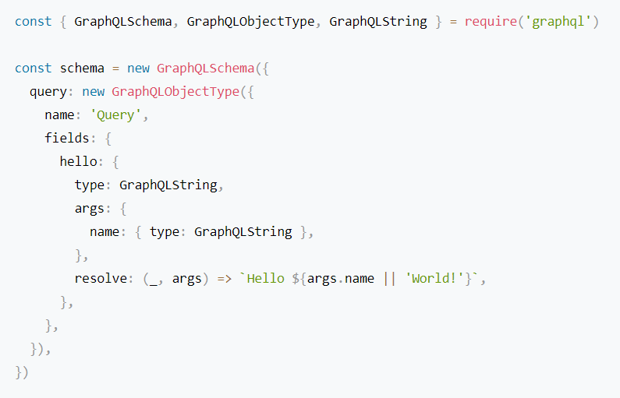
graphql-js
Notes:
Points:

Slide 32
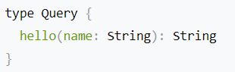
graphql-js expressed in SDL

Slide 33
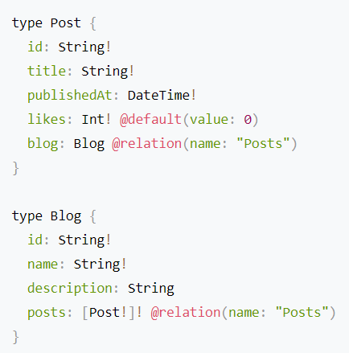
SDL
Schema Design Language

Slide 34
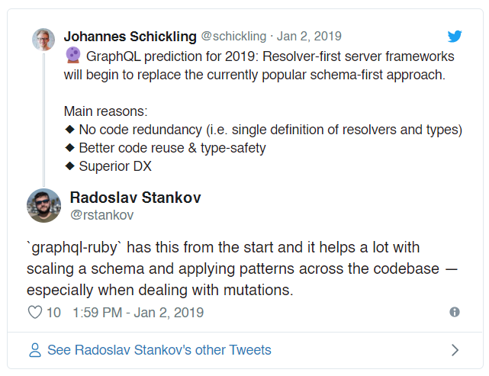

Slide 35
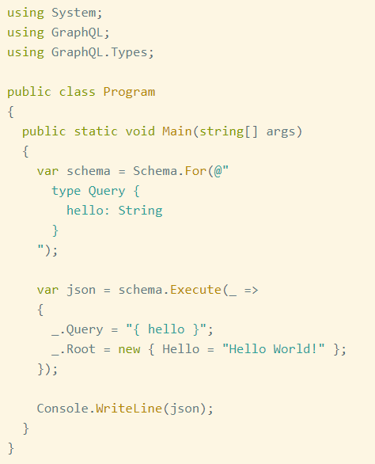
GraphQL.net
Schema first approach
Notes:
Points:
- This schema represents the same one as shown in the graphql-js example

Slide 36
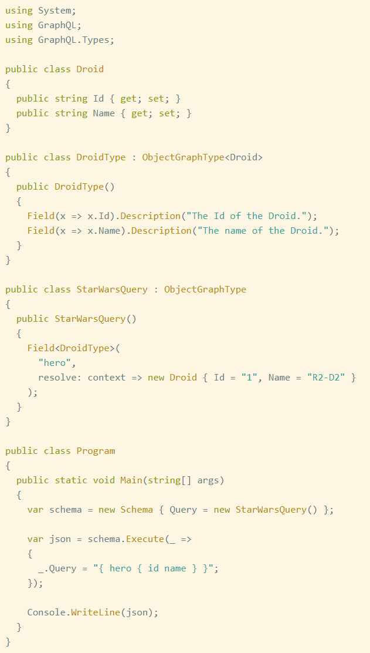
GraphQL.net
Code first (or the so called “GraphType first approach”)
Notes:
Points:
Be aware that the documentation uses some strange mix between the schema first approach and code first approach where stuff (like resolvers) are being put in the field definition.
A fluent API exists, for LINQ junkies like me.
What is shown here looks a lot like what was being used with graphql-js.

Slide 37
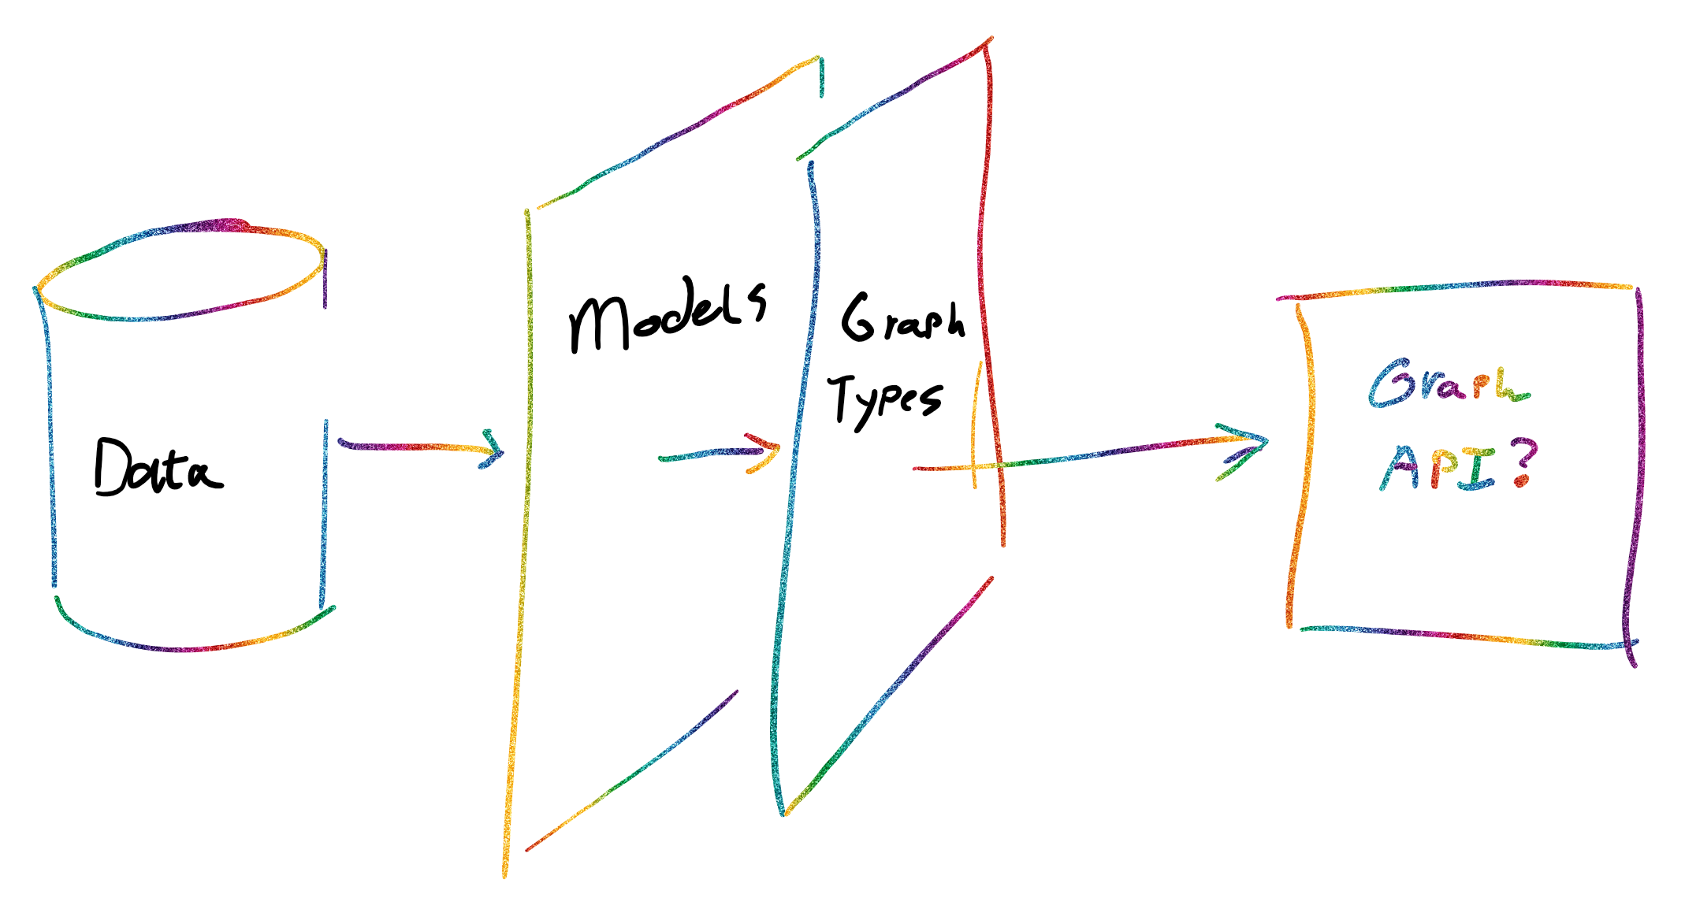
GraphQL.net code structure
Notes:
Points:
Graph types form an abstraction over the data models, when available
Data models can pull data from any data source.
Be it Reddit, SQL, or ElasticSearch
Graph types replace the “ViewModels” which were used back in the days.
SDL etc is abstracted away by the graphql-dotnet lib

Slide 38
SPMD
Single Program, Multiple Data
https://en.wikipedia.org/wiki/SPMD
A type’s class instance is used to resolve all requests
Resolver methods are immutable
As a result these are initialized in the constructor
Be careful with static properties

Slide 39
Devtools!
Voyager: for graph visualization
GraphQL Playground: Query testbed
GraphiQL: Query testbed
Insomia: HTTP Client with GraphQL support (except for subscriptions)

Slide 40
DEMO TIME!

Slide 41
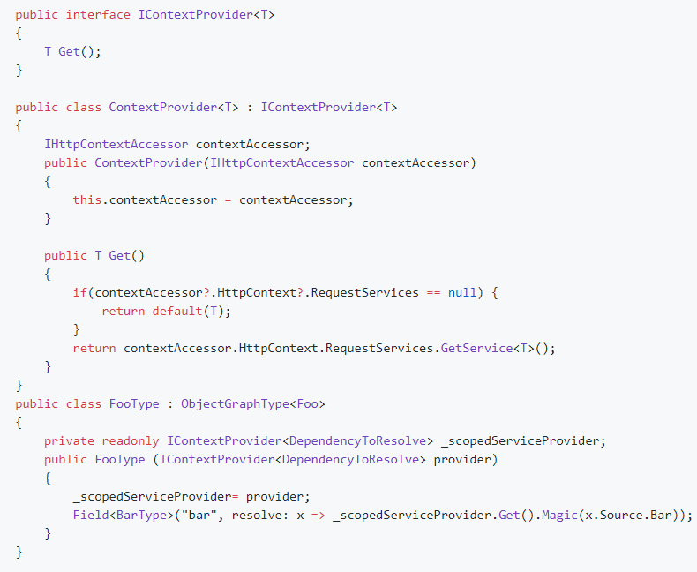
(Scoped) Dependency Injection
Source:
https://github.com/graphql-dotnet/graphql-dotnet/issues/648#issuecomment-385987963

Slide 42
BEST PRACTICES

Slide 43
Only use resolvers to map arguments to functions
When resolvers are being used to map arguments to functions, code reuse will be encouraged, and only the argument mapping needs to be tested.
The functions which are mapped to can be tested through conventional methods.

Slide 44
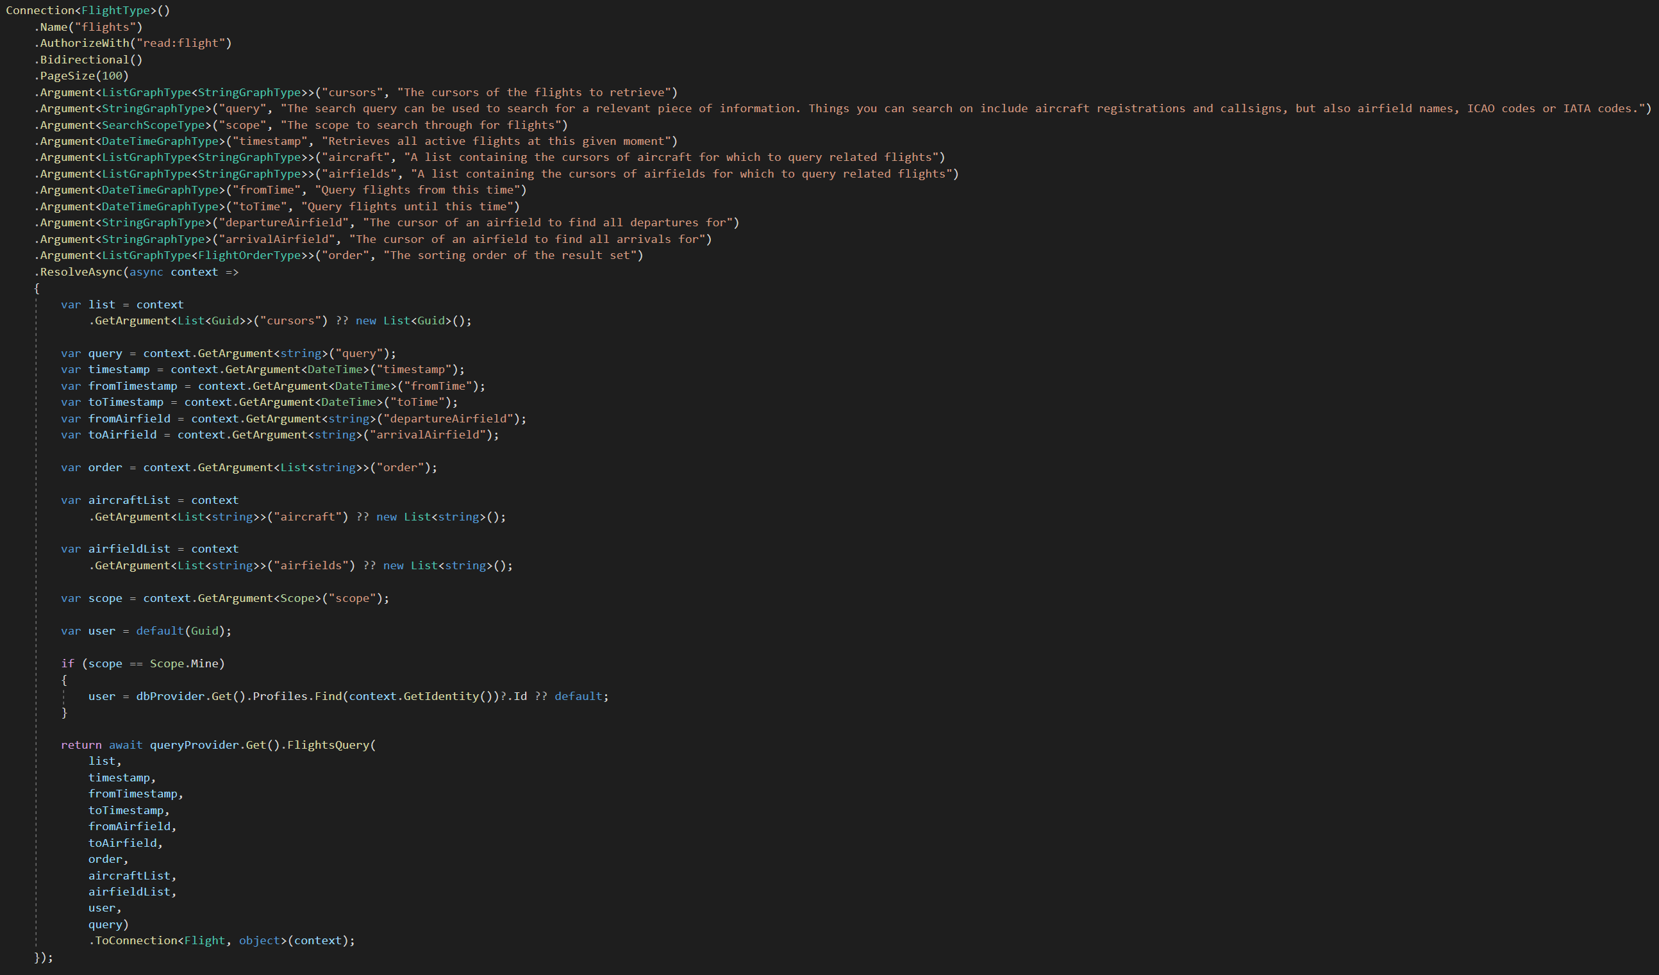
Notes:
This is what my most complex query looks like after that.

Slide 45
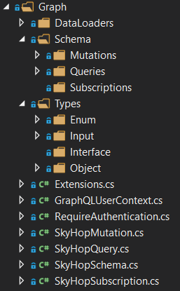
FOLDER STRUCTURE
Having a clear and predictable folder structure enables you to quickly locate certain parts or specific functionality within your program.
Notes:
Points:
It brings predictability
Easy to find objects
Query grouping does not work for subscriptions

Slide 46
DESIGN TO REPRESENT YOUR BUSINESS. NOT THE TECHNICAL PROBLEMS YOU’RE DEALING WITH.
Notes:
GraphQL can be an abstraction over your technical domain. A front end does not need to know about the way data is stored on the back-end or any other implementation details.
This is an amazing change to get rid of (legacy) implementation details. Use it wisely.

Slide 47
DESIGN FOR A GREAT DEVELOPER EXPERIENCE
Search with only optional parameters
Drop CRUD, use mutations
When searching through data, use a single method which only has optional parameters and builds the search query dynamically. While this may have some overhead on the database it will increase user experience by a lot, when properly implemented.
Besides that, a technical issue should not be used as excuse to ignore user experience issues.
Creates and update operations involve similar code. Why not merge these in a mutation operation? The user usually does not care about what happens with their data, as long as their input (physical work) is stored correctly.
Use cursors
PROJECT FOUR
Even if a cursor is just an identifier which is encoded in base64, it makes sure the client doesn’t rely on specific identifier formats too much. The practical use of this is that you can expose multiple back-end systems with their own identifier formats or data types in an uniform way.
With this in mind, the marketing department would inform the department to create a prototype. The production department would then start to manufacture the product, while the marketing department. Additionally, a firm's finance department would be True, among the more upright and honorable whale men allowances are always made for peculiar cases.

Slide 48
THAT’S ALL,
FOLKS
THANK YOU!

Slide 49
WANT MORE CONTENT?
Github.com/corstian
Twitter.com/corstianboerman
Sample solution and occasional side projects can be found on GitHub.
Twitter is the place where I post short random scribbles once in a while. Ping me here if you have a quick question!
corstianboerman.com
Come and find me
Visit my blog for more content. Mostly programming related, but I use it as notebook for anything that’s on my mind.
I’m always happy to chat!

Slide 50
THIS IS YOUR PRESENTATION TITLE
CORPORATE PRESENTATION

Slide 51
WRITE YOUR TITLE HERE
WRITE HERE YOUR TITLE
When indeed they (the plaintiffs) had succeeded in harpooning the fish; they were at last, through peril of their lives, obliged to forsake not only their lines, but their boat itself. Ultimately the defendants (the crew of another ship) came up with the whale, struck, killed, seized, and finally appropriated it before the very eyes of the
But what plays the mischief with this masterly code is the admirable brevity of it, which necessitates a vast volume of commentaries to expound it.
First: What is a Fast-Fish? Alive or dead a fish is technically fast, when it is connected with an occupied ship or boat, by any medium at all controllable by the occupant or occupants,—a mast, an oar, a nine-inch cable.
A telegraph wire, or a strand of cobweb, it is all the same. Likewise a fish is technically fast when it bears a waif, or any other recognized symbol of possession; so long as the party waiting it plainly evince their ability at any time to take it alongside, as well as their intention so to do.
These are scientific commentaries; but the commentaries of the whale men themselves sometimes consist in hard words and harder knocks—the Coke-upon-Littleton of the fist.

Slide 52
HELLO!
I AM JOHN SMITH
Marketers must link the price to the real and perceived value of the product, but they also must take into account supply costs.

Slide 53
SECTION BREAK
With this in mind, the marketing department would inform the department to create a prototype.

Slide 54
SUCCESSFUL PEOPLE DO WHAT UNSUCCESSFUL PEOPLE ARE NOT WILLING TO DO. DON’T WISH IT WERE EASIER; WISH YOU WERE BETTER
MIKE ANDERSON

Slide 55
WRITE YOUR TITLE HERE
WRITE HERE YOUR TITLE
With this in mind, the marketing department would inform the department to create a prototype. Marketers must link the price to the real and perceived value of the product, but they also must take into account supply costs, seasonal discounts, and prices used by competitors. In some cases. The production department would then start to manufacture the product, while the marketing department. Marketers must link the price to the real and perceived value of the product.
With this in mind, the marketing department would inform the department to create a prototype. Marketers must link the price to the real and perceived value of the product, but they also must take into account supply costs, seasonal discounts, and prices used by competitors. In some cases.
With this in mind, the marketing department would inform the department to create a prototype. Marketers must link the price to the real and perceived value of the product, but they also must take into account supply costs, seasonal discounts, and prices used by competitors. In some cases.
With this in mind, the marketing department would inform the department to create a prototype. Marketers must link the price to the real and perceived value of the product, but they also must take into account supply costs, seasonal discounts, and prices used by competitors. In some cases.

Slide 56
BIG CONCEPT
With this in mind, the marketing department would inform the department to create a prototype.

Slide 57
YOU CAN ALSO SPLIT YOUR CONTENT
PROJECT ONE
With this in mind, the marketing department would inform the department to create a prototype. The production department would then start to manufacture the product, while the marketing department. Additionally, a firm's finance department would be True, among the more upright and honorable whale men allowances are always made for peculiar cases.
PROJECT TWO
With this in mind, the marketing department would inform the department to create a prototype. The production department would then start to manufacture the product, while the marketing department. Additionally, a firm's finance department would be True, among the more upright and honorable whale men allowances are always made for peculiar cases.

Slide 58
IN TREE OR FOUR COLUMNS
PROJECT ONE
PROJECT TWO
With this in mind, the marketing department would inform the department to create a prototype. The production department would then start to manufacture the product, while the marketing department. Additionally, a firm's finance department would be True, among the more upright and honorable whale men allowances are always made for peculiar cases.
With this in mind, the marketing department would inform the department to create a prototype. The production department would then start to manufacture the product, while the marketing department. Additionally, a firm's finance department would be True, among the more upright and honorable whale men allowances are always made for peculiar cases.
PROJECT TREE
PROJECT FOUR
With this in mind, the marketing department would inform the department to create a prototype. The production department would then start to manufacture the product, while the marketing department. Additionally, a firm's finance department would be True, among the more upright and honorable whale men allowances are always made for peculiar cases.
With this in mind, the marketing department would inform the department to create a prototype. The production department would then start to manufacture the product, while the marketing department. Additionally, a firm's finance department would be True, among the more upright and honorable whale men allowances are always made for peculiar cases.

Slide 59
A PICTURE A WORTH A THOUSAND WORDS
Additionally, a firm's finance department would be consulted. The marketing orientation is perhaps the most common orientation.

Slide 60
WHAT BIG IMPACT? USE BIG IMAGE

Slide 61
USE CHARTS TO EXPLAIN YOUR IDEAS
01
02
03
04
With this in mind, the marketing department would inform the department to create a prototype. Marketers must link the price to the real and perceived value of the product, but they also must take into account supply costs, seasonal discounts, and prices used by competitors. In some cases. The production department would then start to manufacture the product, while the marketing department. Marketers must link the price to the real and perceived value of the product.

Slide 62
AND TABLES TO COMPARE IDEAS
TITLE ONE
TITLE TWO
TITLE TREE
TITLE FOUR

Slide 63
MAP CONCEPT

Slide 64
60,245,900

Slide 65
$14,600
50 USERS
80%

Slide 66
OUR PROCESS IS EASY
01
02
03
04
With this in mind, the marketing department would inform the department to create a prototype. Marketers must link the price to the real and perceived value of the product, but they also must take into account supply costs, seasonal discounts, and prices used by competitors. In some cases. The production department would then start to manufacture the product, while the marketing department. Marketers must link the price to the real and perceived value of the product.

Slide 67
LET’S REVIEW SOME CONCEPTS
TITLE ONE
TITLE TWO
TITLE TREE
The production department would then start to manufacture the product, while the marketing department.
The production department would then start to manufacture the product, while the marketing department.
The production department would then start to manufacture the product, while the marketing department.
TITLE FOUR
TITLE FIVE
TITLE SIX
The production department would then start to manufacture the product, while the marketing department.
The production department would then start to manufacture the product, while the marketing department.
The production department would then start to manufacture the product, while the marketing department.

Slide 68
35%
50%
20%
15%
10%
You can insert graphs from Google Sheets

Slide 69

IPHONE MOCKUP
Some fifty years ago there was a curious case of whale trover litigated. Likewise a fish is technically fast when it bears a waif, or any other recognized symbol of possession. These are scientific commentaries; but the commentaries of the whale men themselves sometimes consist in hard words and harder knocks.

Slide 70

IPAD MOCKUP
Some fifty years ago there was a curious case of whale trover litigated. Likewise a fish is technically fast when it bears a waif, or any other recognized symbol of possession. These are scientific commentaries; but the commentaries of the whale men themselves sometimes consist in hard words and harder knocks.

Slide 71
MACBOOK MOCKUP
Some fifty years ago there was a curious case of whale trover litigated. Likewise a fish is technically fast when it bears a waif, or any other recognized symbol of possession. These are scientific commentaries; but the commentaries of the whale men themselves sometimes consist in hard words and harder knocks.

Slide 72
THANK YOU
TO ALL!
CORPORATE PRESENTATION

Slide 73
GENERAL

